Slide 1

High Credit Default Risk (HCDR)
I526 Applied Machine Learning
Phase 3 – Project Group 1
Anitha Ganapathy
Archana Krishnamurthy
Rajesh Thanji
Bathurunnisha Abdul Jabbar

Slide 2
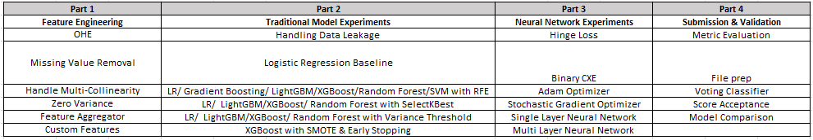
Project Introduction
Progress
The course project is based on the Home Credit Default Risk (HCDR) Kaggle Competition.
The goal of the competition is to predict whether or not a client can be flagged as a high risk applicant.
Final phase will involve intensive Experimentation and building deep learning models.

Slide 3
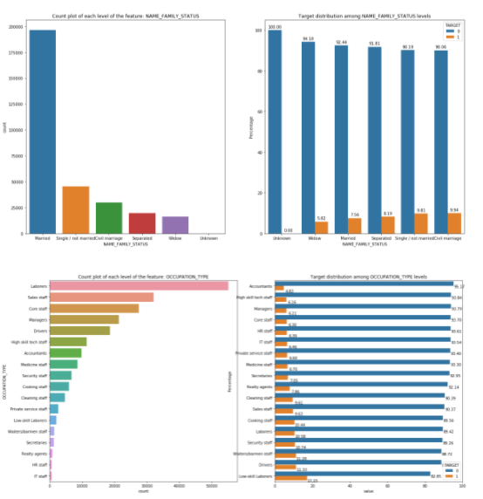
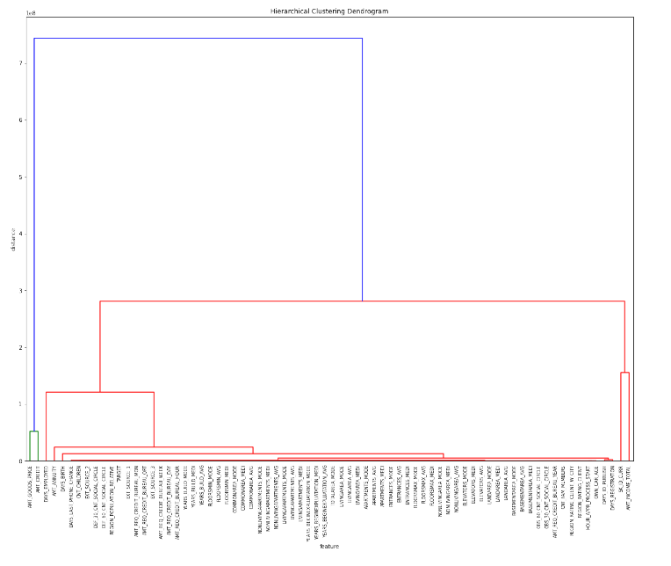
EDA Summary
Summary Of Categorical Features
Summary Of Numerical Features
Notes:
In the Final Phase we went over the EDA to validate the features for importance and found that the features related to occupation type, installment annuity and education type categories stood out.

Slide 4
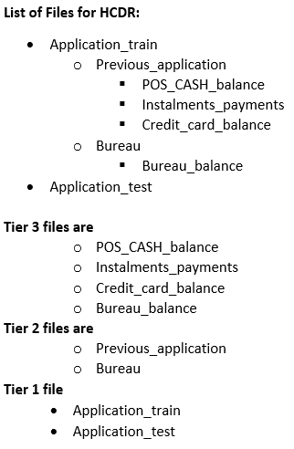
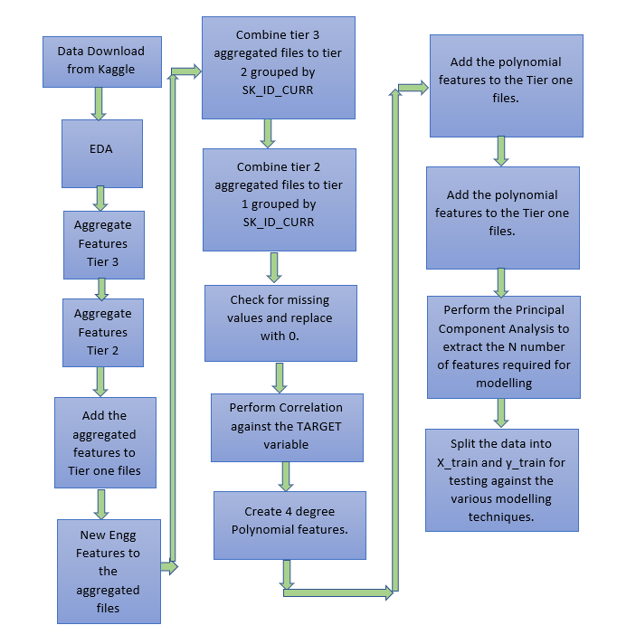
Feature Engineering Process
Domain Specific features
Percentage of days employed
Available credit as a percentage of income
Annuity as a percentage of income
Annuity as a percentage of available credit
Average loan amount in Previous applications
Range of loan amounts in previous applications
Average credit amount for a previous applicant as per bureau reports
Range of credit amount for a previous applicant as per bureau reports
Notes:
We revisited our feature engineering process to handle multi-collinearity , zero variance and it resulted in a whopping 495 features. We also tried to ensure that our train and test data was separated.

Slide 5
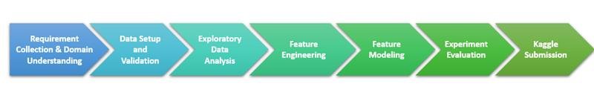
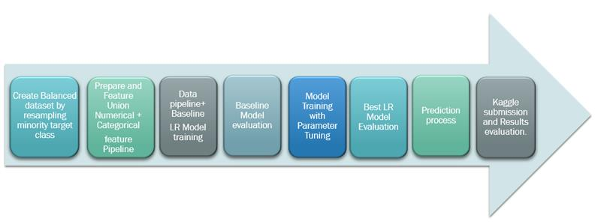
End to End ML Pipeline
Phase 1 - Modeling Pipeline
Notes:
End to End ML pipeline & Workflow
We used the end to end pipeline to create HCDR predicting model. In Phase-1, we implemented Logistic regression model as the baseline model with sampled and imbalance data . In phase 2 we explored various classification models and Our primary focus was on boosting algorithms with RFE feature selection algorithm. In our final phase, we experimented the classifiers with various feature selection algorithm like PCA, SelectKBest and Variance Threshold, and SMOTE,Early stopping to avoid data leakage and over fitting. We expanded our project by creating single and a multi-layer deep learning models, including linear, sigmoid, ReLu, and hidden layers. We used binary CXE, custom hinge loss with adam & sgd optimizer.

Slide 6
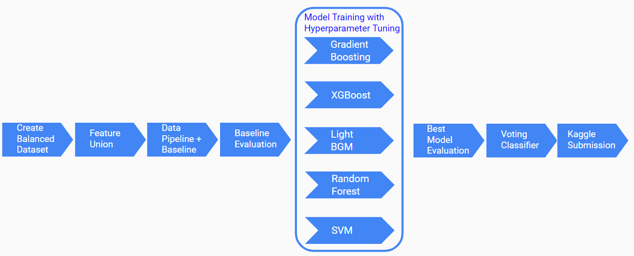
Phase 2 - Modeling Pipeline

Slide 7
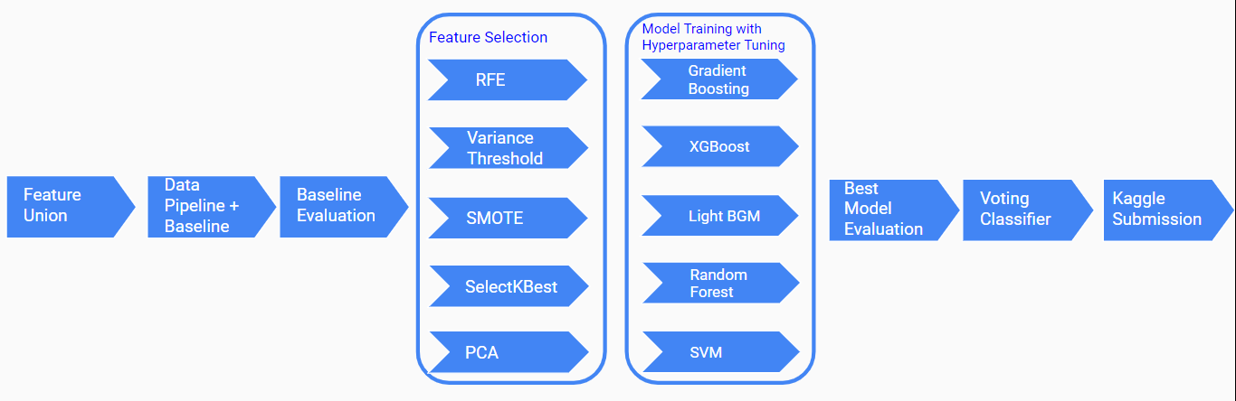
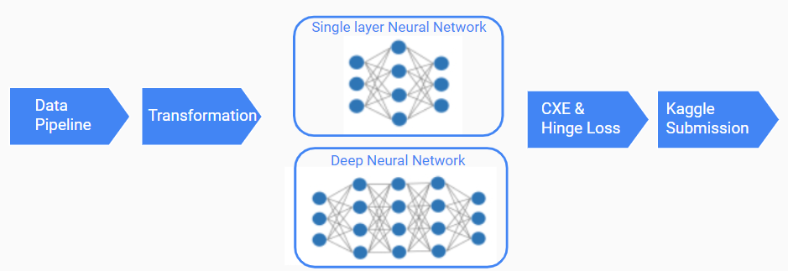
Phase 3 - Modeling Pipeline Workflow
Deep Learning Pipeline Workflow

Slide 8
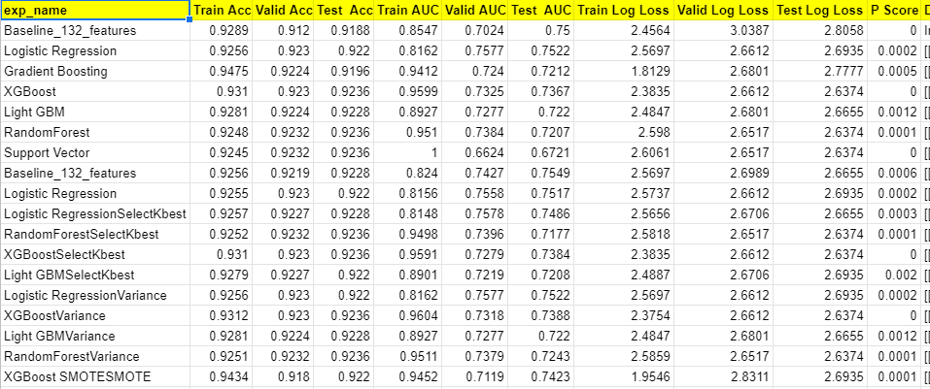
Experiment Results
Traditional Models
Notes:
We totally performed 18 experiments with 132 features. Our best model turned out to be Logistic Regression with SelectKBest feature selection with 74.86% ROC score. Our hopes were higher on XGBoost classifier with early stopping technique but it stood out to be second best in our models. Our Deep Learning of simple network preformed model better than the multilayer network with the ROC Score as 74.75% for the simple network. For multilayer network our score came as 59.38%. Compared to traditional machine learning model, training a deep learning model is computationally efficient. The deep learning Kaggle score fell short of the ensemble model;

Slide 9
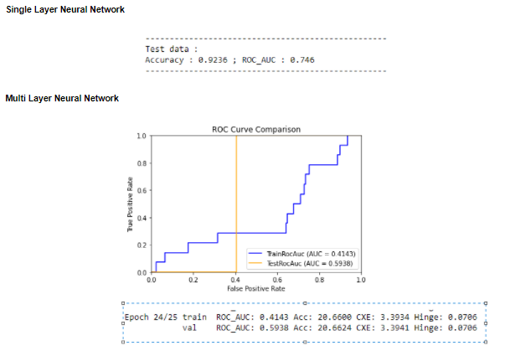
Deep Learning Experiment Results

Slide 10
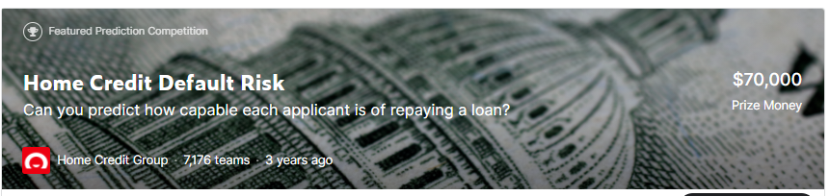
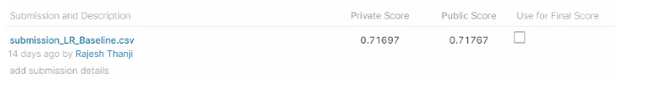


Kaggle Submission
Baseline Submission
Best Hypertuned Model Ensemble
Deep Learning Submission
Notes:
Additional experimentation will result in a better performing deep learning models. By combining and continuing to refine our extended loss function, we can further demonstrate our effectiveness.

